Slide 1
DATABASE MANAGEMENT SYSTEM PROJECT REVIEW
Department of Artificial Intelligence and Data Science
Academic Year: 2024 – 2025 (Even Semester)
Register Number : 2303811724321069
Name : MOHAMMED RAASITH H
Year : II
Semester : IV
Section : B
Date : 29-05-2025

Slide 2
Title of the Project
ONLINE VOTING SYSTEM

Slide 3
Problem Identified
Many groups like businesses and communities need a fast and simple way to collect opinions and make decisions.
Traditional methods such as paper voting or emails are often slow, confusing, and prone to errors or biased results.
An Online Voting System allows users to create polls, share them, and securely collect votes in real-time.

Slide 4
Objective
The goal of this project is to create an Online Voting System that lets users easily make and manage polls or surveys.
It provides a simple and secure way for people to cast their votes quickly.
The system collects votes in real-time and shows results instantly to ensure transparency.
Users can create polls, submit votes, and see dynamic results all in one place.

Slide 5
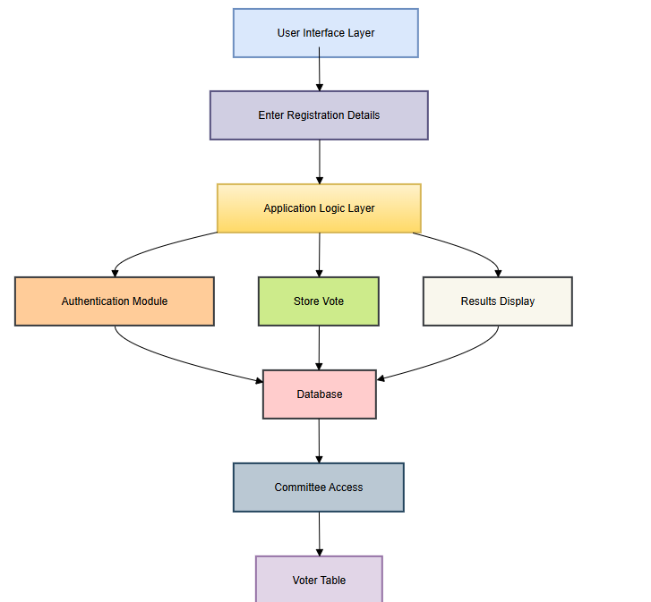
Proposed Architecture

Slide 6
Module List
USER REGISTRATION
USER LOGIN
CASTING A VOTE
VOTE RECORDED – CONFIRMATION
ADMIN VIEWING THE RESULTS

Slide 7
Module Implemented
USER REGISTRATION:
Users enter basic details like name, email, and password to create an account.
The system checks that the information is correct and valid
.A confirmation step may be done through email or phone
.Once registered, users can access personalized features and services.

Slide 8
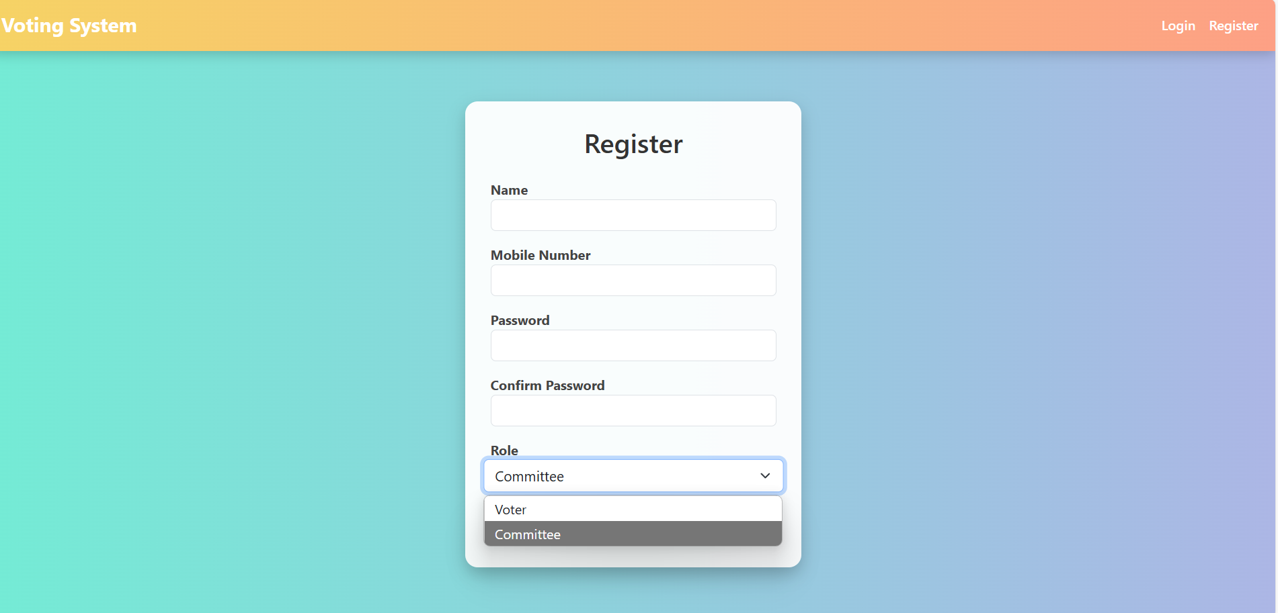
Module Implemented

Slide 9
Module Implemented
USER LOGIN:
Registered users log in using their email and password.
The system checks the credentials for a match.
Security measures protect the account from unauthorized access.
After login, users can access their personalized content and features.

Slide 10
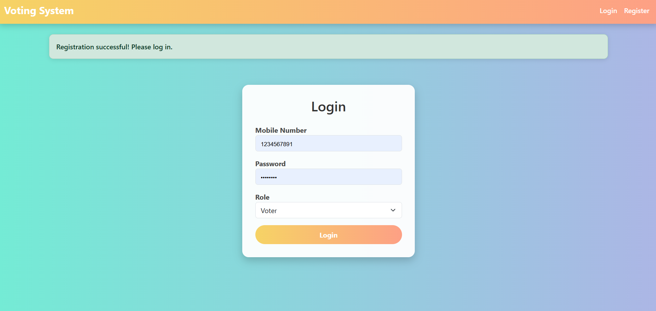
Module Implemented

Slide 11
Module Implemented
CASTING A VOTE
The voter is verified and ready to cast their vote.
They view the list of candidates or options on the screen.
The voter selects their preferred choice carefully.
The vote is submitted and securely recorded in the system.

Slide 12
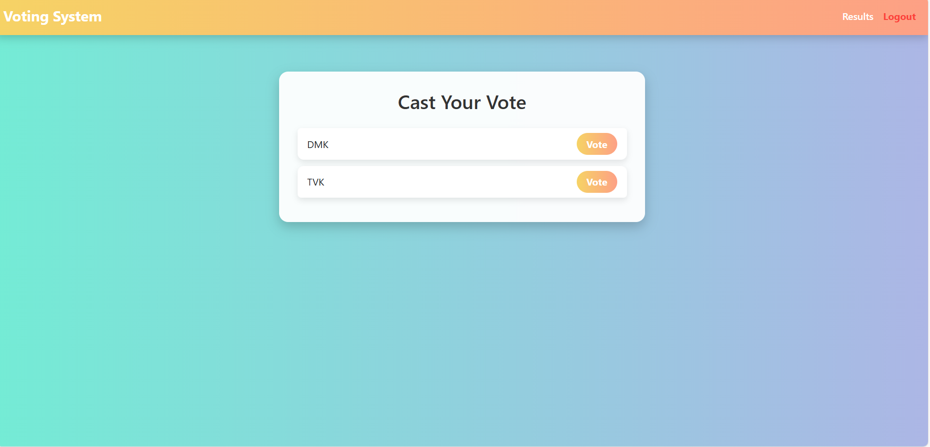
Module Implemented

Slide 13
Module Implemented
VOTE RECORDED – CONFIRMATION:
The user selects their vote and clicks the submit button.
The system records the vote securely in the database.
A confirmation message is shown to the user.
The user is informed that their vote has been successfully recorded.
.

Slide 14
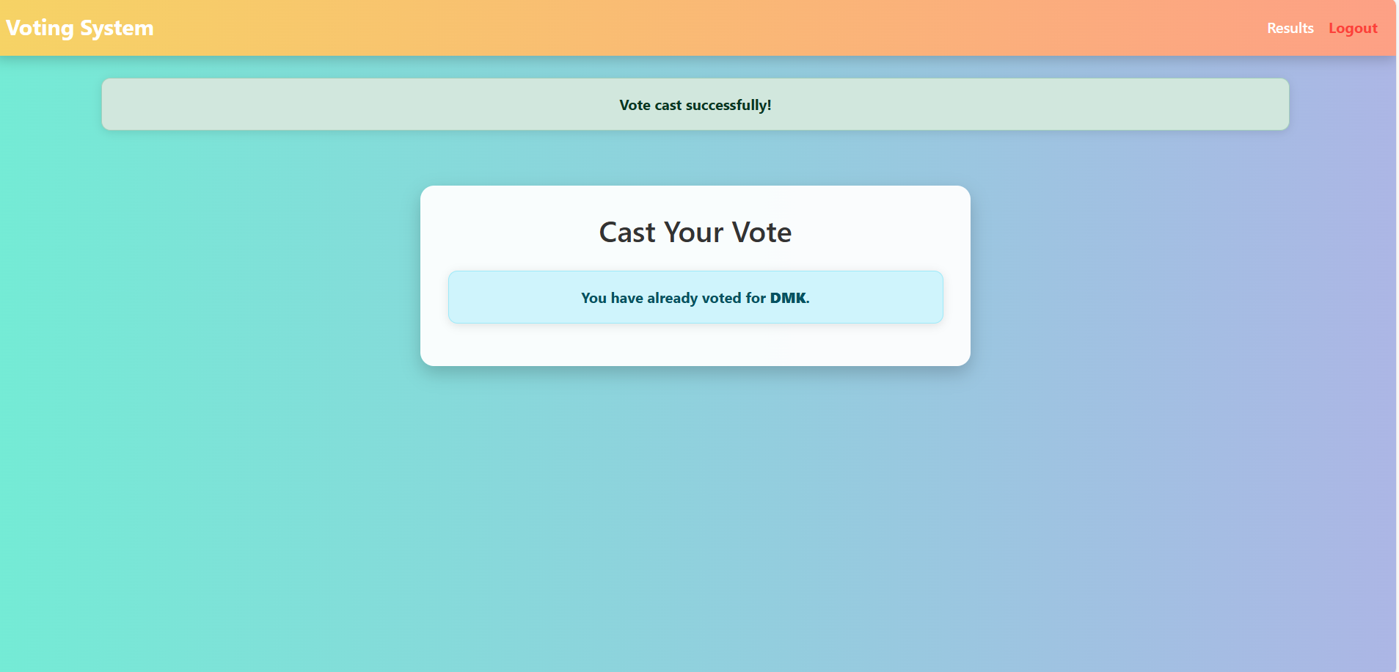
Module Implemented

Slide 15
Module Implemented
ADMIN VIEWING THE RESULTS
The admin logs into the system with secure credentials.
The admin accesses the results dashboard or report section.
The system displays the voting results in real-time or after voting ends.
The admin can analyze, download, or share the results as needed.

Slide 16
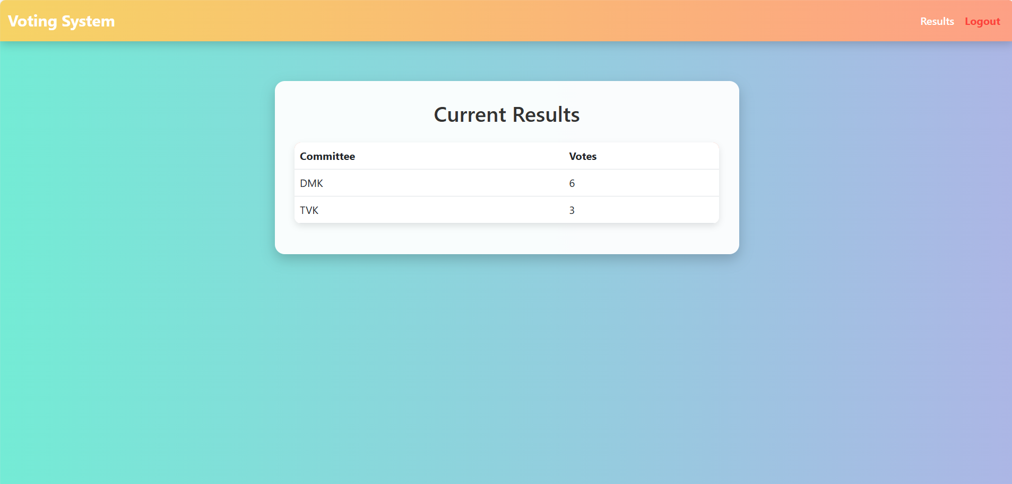
Module Implemented

Slide 17
Conclusion
Conclusion: The online voting system offers a secure, efficient, and accessible way to vote remotely. It minimizes errors, accelerates vote counting, and ensures transparency. Overall, it boosts voter participation and trust in the process.
Future Scope: Future upgrades could include biometric login and blockchain for added security. Support for multiple languages and mobile apps can improve accessibility. Real-time result tracking will enhance transparency and engagement.

Slide 18
Thank You
Any queries???

